Slide 1
Game AI Session 02
Course : COMP6228 – Artificial Intelligence
Effective Period : February 2018

Slide 2
Learning Objective
After completing this session, students are expected to be able to:
LO 1 : Describe how Artificial Intelligence works in Games

Slide 3
Content
The Complexity Fallacy
The Kind of AI in Games
Speed and Memory
The AI Engine

Slide 4
The Complexity Fallacy
It is a common mistake to think that the more complex the AI in a game, the better the characters will look to the player.
Creating good AI is all about matching the right behaviors to the right algorithms.

Slide 5
The Complexity Fallacy
When Simple Things Look Good
Pac-Man (1979) is one of the first games with any form of character AI. The AI has two states: one normal state when the player is collecting pips and another state when the player has eaten the power-up and is out for revenge.
In their normal state, each of the four ghosts (or monsters) moves in a straight line until it reaches a junction. At a junction, they semi-randomly choose a route to move to next. Each ghost chooses either to take the route that is in the direction of the player (as calculated by a simple offset to the player’s location, no pathfinding at work) or to take a random route. The choice depends on the ghost: each has a different likelihood of doing one or the other.

Slide 6
The Complexity Fallacy
When Simple Things Look Good
This is about as simple as you can imagine an AI.
Any simpler and the ghosts would be either very predictable (if they always homed in) or purely random.
The combination of the two gives great gameplay.
The same thing has been reported by many other developers on their games.

Slide 7
The Complexity Fallacy
When Complex Things Look Bad
The opposite thing can easily happen.
A game that many looked forward to immensely was Herdy Gerdy (2002), one of the games Sony used to tout the new gameplay possibilities of their PlayStation 2 hardware before it was launched.
The game is a herding game. An ecosystem of characters is present in the game level. The player has to herd individuals of different species into their corresponding pens. Herding had been used before and has since as a component of a bigger game, but in Herdy Gerdy it constituted all of the gameplay.

Slide 8
The Complexity Fallacy
When Complex Things Look Bad
Knowing when to be complex and when to stay simple is the most difficult element of the game AI programmer’s art.
The best AI programmers are those who can use a very simple technique to give the illusion of complexity.

Slide 9
The Complexity Fallacy
The Perception Window
If we only catch a glimpse of someone for a short while, we don’t have enough time to understand their situation.
If we see a guard who has heard a noise suddenly turn away and move slowly in the opposite direction, we assume the AI is faulty. The guard should have moved across the room toward the noise.
If we do hang around for a bit longer and see the guard head over to a light switch by the exit, we will understand his action.

Slide 10
The Complexity Fallacy
The Perception Window
Then again, the guard might not flick on the light switch, and we take that as a sign of poor implementation.
But the guard may know that the light is inoperable, or he may have been waiting for a colleague to slip some cigarettes under the door and thought the noise was a predefined signal.
If we knew all that, we’d know the action was intelligent after all.

Slide 11
The Complexity Fallacy
Changes of Behavior
The perception window isn’t only about time.
Whenever a character in a game changes behavior, the change is far more noticeable than the behavior itself.
A change in behavior almost always occurs when the player is nearby or has been spotted.
This is the same in platform games as it is in real-time strategy. A good solution is to keep only two behaviors for incidental characters—a normal action and a player-spotted action.

Slide 12
The Kind of AI in Games
Games have always come under criticism for being poorly programmed (in a software engineering sense): they use tricks, arcane optimizations, and unproven technologies to get extra speed or neat effects.
Game AI is no different.
One of the biggest barriers between game AI people and AI academics is what qualifies as AI.

Slide 13
The Kind of AI in Games
Hacks
For in-game AI, behaviorism is often the way to go. We are not interested in the nature of reality or mind; we want characters that look right. In most cases, this means starting from human behaviors and trying to work out the easiest way to implement them in software.
Good AI in games usually works in this direction. Developers rarely build a great new algorithm and then ask themselves, “So what can I do with this?” Instead, you start with a design for a character and apply the most relevant tool to get the result.

Slide 14
The Kind of AI in Games
Heuristics
A heuristic is a rule of thumb, an approximate solution that might work in many situations but is unlikely to work in all.
Common Heuristics:
Most Constrained
Do the Most Difficult Thing First
Try the Most Promising Thing First

Slide 15
The Kind of AI in Games
Algorithms
Hacks and heuristics will get you a long way, but relying on them solely means you’ll have to constantly reinvent the wheel.
General bits of AI, such as movement, decision making, and tactical thinking all benefit from tried and tested methods that can be endlessly reused.

Slide 16
Speed and Memory
The biggest constraint on the AI developer’s job is the physical limitations of the game’s machine.
Game AI doesn’t have the luxury of days of processing time and gigabytes of memory.
Developers often work to a speed and memory budget for their AI.

Slide 17
Speed and Memory
Processor Issues
SIMD
Multi-Core Processing and Hyper-Threading
Virtual Functions/Indirection
Memory Concerns
Cache
PC Constraints
Console Constraints

Slide 18
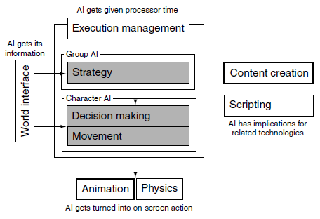
The AI Engine
Structure of an AI Engine

Slide 19
The AI Engine
Toolchain Concerns
The complete AI engine will have a central pool of AI algorithms that can be applied to many characters.
An increasing number of companies are developing AI components in their toolchain: editors for setting up character behaviors and facilities in their level editor for marking tactical locations or places to avoid.
Being toolchain driven has its own effects on the choice of AI techniques. It is easy to set up behaviors that always act the same way.

Slide 20
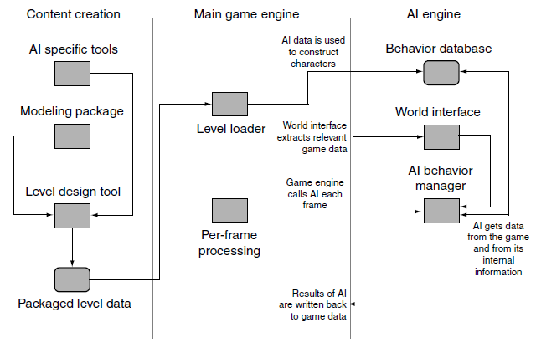
The AI Engine
Putting It All Together

Slide 21
References
Ian Millington. 2009. Artificial intelligence for games. Morgan Kaufmann Publishers. Burlington. ISBN:9780123747310
7 examples of game AI that every developer should study, http://www.gamasutra.com/view/news/269634/7_examples_of_game_AI_that_every_developer_should_study.php

